Slide 1
FASTAPI Development using Python on Cloud
FastAPI with Agentic AI on Cloud

Slide 2
Form Models in FastAPI
In FastAPI, Pydantic models are used to define the structure, data types, and validation rules for form data.
To handle form data, you must explicitly use the Form() dependency for each field within a path operation or a Pydantic model (in recent versions of FastAPI).

Slide 3
Request Files in FastAPI
To request files in FastAPI, you define a path operation function with a parameter typed as UploadFile or bytes, and use the File class to ensure it's handled as form data.
For handling single files, the UploadFile class is generally preferred over bytes because it handles large files more efficiently by spooling them to disk if they exceed a certain memory limit (defaulting to 1 MB), preventing excessive memory consumption.
To handle multiple files, define the parameter as a list[UploadFile]. You can then iterate through the list of files in the request.

Slide 4
Handling Error in FastAPI
HTTPException is a normal Python exception with additional data relevant for APIs.
Because it's a Python exception, you don't return it, you raise it.
This also means that if you are inside a utility function that you are calling inside of your path operation function, and you raise the HTTPException from inside of that utility function, it won't run the rest of the code in the path operation function, it will terminate that request right away and send the HTTP error from the HTTPException to the client.
The benefit of raising an exception over returning a value will be more evident in the section about Dependencies and Security.

Slide 5
FastAPI Encoding with JSON Compatible Encoders
There are some cases where you might need to convert a data type (like a Pydantic model) to something compatible with JSON (like a dict, list, etc).
For example, if you need to store it in a database.
For that, FastAPI provides a jsonable_encoder() function.

Slide 6
Dependency Injection with FastAPI
"Dependency Injection" means, in programming, that there is a way for your code (in this case, your path operation functions) to declare things that it requires to work and use: "dependencies".
And then, that system (in this case FastAPI) will take care of doing whatever is needed to provide your code with those needed dependencies ("inject" the dependencies).
This is very useful when you need to:
Have shared logic (the same code logic again and again).
Share database connections.
Enforce security, authentication, role requirements, etc.
IoC (Inversion of Control)

Slide 7
Dependencies with yield and HTTPException
you can use dependencies with yield and have try blocks that try to execute some code and then run some exit code after finally.
You can also use except to catch the exception that was raised and do something with it.

Slide 8
CORS (Cross-Origin Resource Sharing)
An origin is the combination of protocol (http, https), domain (myapp.com, localhost, localhost.tiangolo.com), and port (80, 443, 8080).
So, all these are different origins:
http://localhost
https://localhost
http://localhost:8080
Even if they are all in localhost, they use different protocols or ports, so, they are different "origins".

Slide 9
Implementation Steps for CORS
Suppose you have a frontend running in your browser at http://localhost:8080, and its JavaScript is trying to communicate with a backend running at http://localhost (because we don't specify a port, the browser will assume the default port 80).
Then, the browser will send an HTTP OPTIONS request to the :80-backend, and if the backend sends the appropriate headers authorizing the communication from this different origin (http://localhost:8080) then the :8080-browser will let the JavaScript in the frontend send its request to the :80-backend.
To achieve this, the :80-backend must have a list of "allowed origins".
In this case, the list would have to include http://localhost:8080 for the :8080-frontend to work correctly.

Slide 10
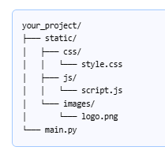
Static Files in FastAPI
To serve static files like CSS, JavaScript, and images in FastAPI, you must use the StaticFiles class and the app.mount() method. This "mounts" a given local directory to a specific URL path in your application, allowing the files within to be served to clients.

Slide 11
Accessing the Files in StaticFiles
  "/static": The URL sub-path where the files will be accessible (e.g., http://localhost:8000/static/style.css).
  directory="static": The name of the local directory containing your static files.
  name="static": An internal name used by FastAPI's path-building functions.
Access the Files: Once your server is running (e.g., uvicorn main:app --reload), you can access your static files in the browser or link to them in your HTML templates using the specified URL path.
  For the logo.png image in the example structure: http://localhost:8000/static/images/logo.png.
  To link a CSS file in an HTML template: <link rel="stylesheet" href="/static/css/style.css">.

Slide 12
Advanced Status Codes
By default, FastAPI will return the responses using a JSONResponse, putting the content you return from your path operation inside of that JSONResponse.
If you want to return additional status codes apart from the main one, you can do that by returning a Response directly, like a JSONResponse, and set the additional status code directly.
For example, let's say that you want to have a path operation that allows to update items, and returns HTTP status codes of 200 "OK" when successful.
But you also want it to accept new items. And when the items didn't exist before, it creates them, and returns an HTTP status code of 201 "Created".
To achieve that, import JSONResponse, and return your content there directly, setting the status_code that you want:

Slide 13
Deployment of FastAPI App with Azure
Pre-requisites
Python 3.10+
Azure Account
Configure a custom startup command that uses Gunicorn to run the asynchronous Uvicorn server, along with ensuring your dependencies are specified correctly.
Deployment can be done using the Azure CLI, Visual Studio Code extensions, or GitHub Actions.

Slide 14
Background Tasks Mgmt in FastAPI
You can define background tasks to be run after returning a response.
This is useful for operations that need to happen after a request, but that the client doesn't really have to be waiting for the operation to complete before receiving the response.
This includes, for example:
Email notifications sent after performing an action:
  As connecting to an email server and sending an email tends to be "slow" (several seconds), you can return the response right away and send the email notification in the background.
Processing data:
  For example, let's say you receive a file that must go through a slow process, you can return a response of "Accepted" (HTTP 202) and process the file in the background.

Slide 15
Create a Task function
Create a function to be run as the background task.
It is just a standard function that can receive parameters.
It can be an async def or normal def function, FastAPI will know how to handle it correctly.
Inside of your path operation function, pass your task function to the background tasks object with the method .add_task():

Slide 16
Overview of Alembic
Alembic provides for the creation, management, and invocation of change management scripts for a relational database, using SQLAlchemy as the underlying engine.
Usage of Alembic starts with creation of the Migration Environment. This is a directory of scripts that is specific to a particular application.
The migration environment is created just once and is then maintained along with the application’s source code itself. The environment is created using the init command of Alembic and is then customizable to suit the specific needs of the application.

Slide 17
Alembic Benefits
Version Control for Your Database: Alembic acts like "Git for your database schema," allowing you to track every change (e.g., adding a table, renaming a column) as an explicit, versioned step in a migration script. This provides a clear, auditable history of modifications.
Consistency Across Environments: It ensures that every developer, testing environment, and the production database uses the exact same schema evolution process. This eliminates "schema drift" and prevents issues caused by manual errors during deployment.
Safe Upgrades and Downgrades (Rollbacks): Each migration script contains instructions for both applying the changes (upgrade) and reversing them (downgrade). This provides a crucial safety net, allowing you to revert to a previous, stable state if a new release encounters problems.
Streamlined Collaboration: Each developer's schema changes are captured in migration files that are checked into the source code repository. Team members can easily pull the latest changes and run a single command to sync their local databases.
Automation and CI/CD Integration: Migrations can be easily integrated into Continuous Integration/Continuous Deployment (CI/CD) pipelines, automating the process of applying database changes during deployment. This makes releases more reliable and predictable.
Pythonic API and SQLAlchemy Integration: Migration scripts are written in Python, allowing developers to leverage the full power and readability of Python code. It works hand-in-hand with SQLAlchemy, the most popular Python ORM, and can automatically generate draft migration scripts based on model definitions.
Database Agnostic: Alembic supports all major databases that SQLAlchemy works with, including PostgreSQL, MySQL, and SQLite, making it a versatile choice for diverse projects.

Slide 18
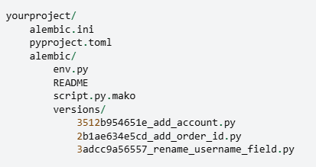
Directory Structure
Alembic.ini -> This is Alembic’s main configuration file which is generated by all templates.
Pyproject.toml – Alembic may store optionally project related configuration.
Yourproject – root of the application.
Alembic – The directory lives within the application source tree and source of migration.
env.py – part of generated environment so that the migration runs are entirely customizable.

Slide 19
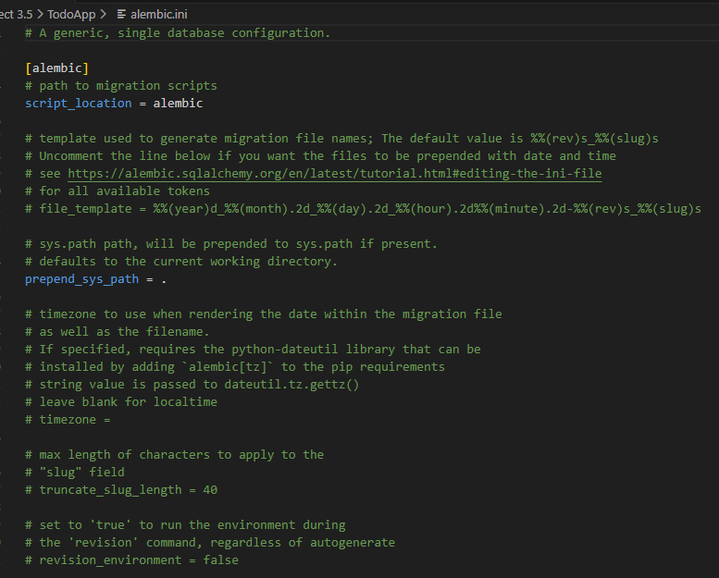
Alembic .ini file

